Slide 1

Sun Cluster 3 overview
Manage the Service, Not the Server

Slide 2
High Availability Overview
Sun Cluster 3.0 Architecture
Sun Cluster 3.0 Administration
Workshop for Sun Cluster 3.0

Slide 3
What's Sun Cluster focused on...
High Availability
There are few metrics to which I pay closer attention than a “system uptime” - how often Sun system are up and running at customer sites.
-- Scott McNealy
Availability = MTBF / (MTBF + MTTR)
MTBF: Mean Time Between Failure
MTTR: Mean Time To Recover

Slide 4
High Availability
99.99% availability is receivable?
Availability% downtime per year
99 3.65 days
99.9 8.76 hours
99.99 52.6 minutes
99.999 5.26 minutes
99.9999 30.00 seconds

Slide 5
Mean Time Between Failure
The MTBF is the average time interval between two consecutive componet failures.
A disk array composed of 50 disks whose MTBF are 50000 hours is configured as a RAID-0 device. Its MTBF is 50000/50 = 1000 hours = 41 days.
Ways to increase overall MTBF
Redundant hardware components
Software: fail over or automatic recovery

Slide 6
High-Availability Strategies of Sun Cluster
 Redundant servers
 Redundant data (vxvm/sds)
 Redundant public network access
 Redundant private communications (transport)
 Multi-host storage access

Slide 7
√High Availability Overview
Sun Cluster 3.0 Architecture
Sun Cluster 3.0 Administration
Workshop for Sun Cluster 3.0

Slide 8
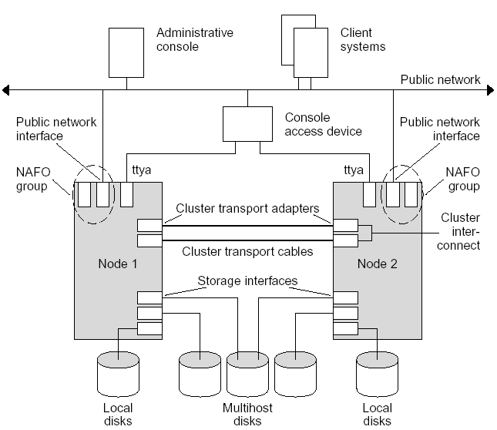
Sample two-node cluster Configuration

Slide 9
Hardware Components
Servers with local storage (storage devices hosted by one node)
Shared storage (storage devices hosted by more than one node)
Cluster Interconnect for private communication among the cluster nodes
Public Network Interfaces for connectivity to the outside world
Administrative Workstation for managing the cluster

Slide 10
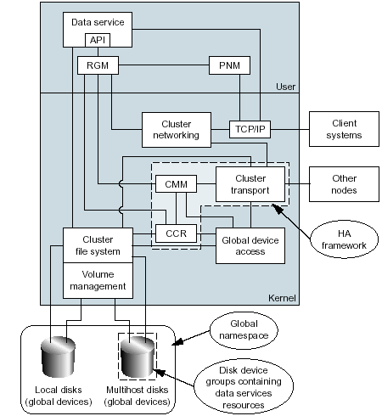
Software Architecture

Slide 11
Software Architecture
Agents
API
Resource Group Mgr
Public Network
Monitor
User
Kernel
Global Network
Service
TCP/IP
Client
System
Cluster Membership
Monitor
Cluster
Transport
Other
Nodes
Cluster Configuration
Repository
Global Device
Access
Global File Service
Volume Mgt
HA Framework
Storage

Slide 12
Software Architecture
Cluster Transport
CMM
CCR
PNM
Global Devices
RGM
Data Services
Volume Management S/W

Slide 13
Cluster Transport
  Communication mechanism for the cluster framework
    Cluster internal messages
    Application level messages
    Data transport
  Abstracts interconnect hardware implementation from the cluster framework
  Failure detection and recovery of interconnects
  CLI command – scconf for configuration
  CLI menu-driven command– scsetup for configuration

Slide 14
CMM
The cluster membership monitor (CMM) is kernel-resident on each node and detects major cluster status changes, such as loss of communication between one or more nodes. The CMM instances communicate with one
another across the private high-speed interconnect network interfaces by sending regular heartbeat messages. If the heartbeat from any node is not detected within a defined time-out period, it is considered as having failed and a cluster reconfiguration is initiated to renegotiate cluster membership.

Slide 15
CMM(cont'd) split brain and CMM
Split brain (adj.) : A condition in which a cluster breaks up into multiple subclusters, with each subcluster forming without the knowledge of the other
  Usually caused by total interconnects failure between cluster nodes
  May result in loss of data integrity
Sun Cluster 3.0 ensures no loss in data integrity through CMM functions
  Majority quorum voting algorithm((n/2)+1)
  Subcluster with major votes survives
  Other subclusters are fenced out from the data
Note: Multiple interconnects (up to 6) may decrease the likelyhood of a split brain scenario

Slide 16
CMM(cont'd) amnesia and CMM
Amnesia (noun) : A condition in which a cluster restarts with stale cluster configuration data
  Usually caused by restarting the cluster from a node that was not part of the latest cluster membership
  May result in loss of data or service integrity
Sun Cluster 3.0 ensures no loss of data or service integrity through CMM functions
  Node can restart a cluster only if it was present in the latest membership before a cluster shutdown
  Sun Cluster 3.0 error messages points to a particular node to restart the cluster

Slide 17
CCR
General cluster configuration information is stored in global configuration files collectively referred to as the cluster configuration repository (CCR). The CCR must be kept consistent between all nodes and is a critical element that enables each node to be aware of its potential role as a
designated backup system. The CCR contains:
Cluster and node names
Current cluster situational parameter values (timeouts)
Paths to data service control routines
Disk ID device configuration
Current cluster status
CCR directory:/etc/cluster/ccr

Slide 18
PNM
The Sun Cluster system provides a proprietary feature, public network management (PNM), that can transfer user I/O from a failed network interface to a predefined backup interface.

Slide 19



Global Devices
Mount Once, Mount Anywhere, Access Everywhere,
and Manage Anywhere
Benefits
Improved availability
Simplified management
Greater flexibility
Features
Cluster-wide access to all devices
Support for disk, tape, and CD-ROM devices
Unique ID for the devices
Global namespace
Domain 1
Domain 2
Domain 3
Domain 4
Domain 5
Domain 6
/dev/global/dsk/d3
/dev/global/rmt/2
Notes:
Global File Services
Finally, we will now drill down and talk about the global file services.
With global file services, one can mount once, mount anywhere, access everywhere, and manage anywhere.
Features
Cluster-wide file system
It's no longer necessary to modify applications & services from all nodes - the file system coordinates simultaneous reading and writing
Let's drill down and look in detail what the global file system does. Global file system is a proxy between the kernel on one node and the underlying files system and volume manager running on a node that has a physical connection to the disks
Independent of underlying file system and volume manager. All the complexity is hidden under the vnode layer, and you can continue to use the file systems and volume managers you have been using: UFS, SDS, VxFS and VxVM
Makes file accesses location transparent: a process can open a file located anywhere in the cluster
Uses coherency protocol to preserve the UNIX file access semantics even if the file is accessed concurrently from multiple nodes
Provides continuous access to data, even when failures occur. Application does not detect failures, as long as there is a path to disks that is still operational.
Global file service mount
mount -g [….same as underlying file system mount arguments…..]
Can be done on any node
Users get the following benefits:
Continuous availability
File system is de-coupled from the application. If a volume should fail, the request is redirected to another volume without restarting the application. The application is typically unaware of any faults, and service interruption is reduced
Concurrent access from all domains
Location of application independent of data
Highly available via storage mirroring
Reduced administration & better change management
The file system can be mounted by any domain in the cluster, and every domain in the cluster sees the global file system with the same mount point. Mount points are not unique to each client, user or server.

Slide 20
Global Devices
Disk ID Devices:
An important component of the Sun Cluster global device technology is the Disk ID (DID) pseudo driver.
symbolic links to device:
/global/.devices/node@nodeID
scdidadm -L
1 boss_sv01:/dev/rdsk/c0t0d0 /dev/did/rdsk/d1
2 boss_sv01:/dev/rdsk/c0t1d0 /dev/did/rdsk/d2
3 boss_sv01:/dev/rdsk/c0t2d0 /dev/did/rdsk/d3
4 boss_sv01:/dev/rdsk/c1t0d0 /dev/did/rdsk/d4
5 boss_sv01:/dev/rdsk/c1t1d0 /dev/did/rdsk/d5
6 boss_sv01:/dev/rdsk/c1t2d0 /dev/did/rdsk/d6
7 boss_sv02:/dev/rdsk/c5t4d0 /dev/did/rdsk/d7
7 boss_sv02:/dev/rdsk/c4t3d0 /dev/did/rdsk/d7
7 boss_sv01:/dev/rdsk/c4t3d0 /dev/did/rdsk/d7
7 boss_sv01:/dev/rdsk/c5t4d0 /dev/did/rdsk/d7
7 boss_sv03:/dev/rdsk/c4t3d0 /dev/did/rdsk/d7
7 boss_sv03:/dev/rdsk/c5t4d0 /dev/did/rdsk/d7

Slide 21

Global File Service
Benefits
Access data from any node
Filesystem operations always complete
Flexible and easy to use
Features
No direct access to storage needed
Uses standard UFS & HSFS filesystems
Mount once mounts on all nodes
Domain 1
Domain 2
Domain 3
Domain 4
Domain 5
Domain 6
Global File Service
Notes:
Scalable & Global Networking Services
Scalable services is built on global storage devices, global file system, and global IP services
Features:
Networking infrastructure for scalable services
Single cluster name for clients: Provides the ability for the cluster itself to have an IP address
Traffic destined for applications registered to work with this cluster-wide (or global) address is distributed to set of nodes running instances of the application for service.
The distribution policy is based on load-balancing policy
Global interface (GIF)
A global network interface that physically hosts shared addresses
Service requests come into the cluster through GIF
Global interface failover
If the node that hosts the global interface fails, the global interface fails over to another node
Scalable application failover
If a node (that does not host GIF) fails, then the instance on that node tries to restart on the same node
If it cannot be restarted on the same node, then it will fail over to an unused node configured to run the service
If the node upon which the data service is running fails, the service is migrated to another working node without user intervention
Load balancing policy
For scalable applications registered with the global IP address
Distribution of packets is done in accordance to the weighted policy
Weighted: the load is distributed among various nodes according to the set weights.
If no weights, then 1/nth of load will get distributed to n-nodes of the cluster
Benefits:
Masks complexitiy
By creating a scalable resource group, the scalable & global networking services are automatically carried out. Requires no manual intervention to enable global interface failover or load balancing.
Enables horizontal scaling
Horizontal scaling (adding more domains to the cluster) can be used to increase capacity and continuity
A single application or series of applications which form a service can run across multiple domains.
Continuous Availability: High availability is enhanced, since service levels are maintained in the event of any number of potential outages, planned or otherwise.
Due to SC 3.0's ability to handle multiple service instances, it ensures that service levels are maintained upon a failure.
There is also inherent HA, since if 4 domains are required to run a service, and one domain fails, then another instance of the service is started on another domain.
Until the service is started on another domain, although at a reduced capacity, service is still available on 3 domains.
Better resource utilization
Once the cluster is set up, administrators need to set policy and SC 3.0 will dynamically balance the load across resources as directed.

Slide 22
Global File Service
Implemented at the vnode layer
Solaris Kernel
vnode layer
Access direct
File System
Volume Manager
Storage
Notes:
The global file service maintains the underline filesystem and the kernel interfaces as per vnode implementation. It is implemented as a proxy file system PxFS and maintains the UNIX file access semantics and the coherency protocols. Please note that this is not a new file system but rather a mechanism that is transparent to your application. There is no need to convert your data or change your current file system. The sysadmin worth noting changes are the "-g" option added in the mount command and the global option in /etc/vfstab file. Due to global file service your file system needs to be mounted once and can be mounted from anywhere in the cluster and is available everywhere in the cluster.

Slide 23
Global File Service
Solaris Kernel
Solaris Kernel
vnode layer
vnode layer
Proxy Client
Proxy Server
vnode layer
vnode layer
File System
access via cluster interconnect
Volume Manager
Storage

Slide 24
RGM
Resource Group Manager
Resource Group
contains Resource
is a Resource Type
Resource Type
Preregistered Resource Types
SUNW.HAStoragePlus
SUNW.LogicalHostname (used by failover data services)
SUNW.SharedAddress (use by scalable data services)
Dataservice Resource Types
Important Third Part Applications(RDBMS/Middleware etc)

Slide 25
Data Services
Sun Cluster HA for Oracle SUNW.oracle_server
SUNW.oracle_listener
Sun Cluster HA for iPlanet SUNW.iws
Sun Cluster HA for Netscape SUNW.nsldap
Directory Server
Sun Cluster HA for Apache SUNW.apache
Sun Cluster HA for Domain SUNW.dns
Name Service (DNS)
Sun Cluster HA for NFS SUNW.nfs
Sun Cluster HA for SAP SUNW.sap_ci
SUNW.sap_as
Sun Cluster HA for Sybase SUNW.sybase

Slide 26
Volume Management
Veritas Volume Manager
Every disk group should be registered and synchronized with scsetup.
Sun Disk Suite

Slide 27
Quorum device
Split Brain
Interconnection / transport failure
Amnesia
Inconsistency of CCR
Quorum Vote Counts
number of nodes – 1 >= quorum votes >= ceil (number of nodes / 2)
Each node counts 1 and disk count (n-1)

Slide 28
Quiz: Quorum device
Considering a 3-node cluster, the quorum device of which contains 2 votes. The topology of this cluster is
N – N. If all transports/interconnections are disconnected simutaneously, what would happen?

Slide 29
Quorum Votes Examble
-- Quorum Summary --
Quorum votes possible: 5
Quorum votes needed: 3
Quorum votes present: 5
-- Quorum Votes by Node --
Node Name Present Possible Status
--------- ------- -------- ------
Node votes: boss_sv01 1 1 Online
Node votes: boss_sv02 1 1 Online
Node votes: boss_sv03 1 1 Online
-- Quorum Votes by Device --
Device Name Present Possible Status
----------- ------- -------- ------
Device votes: /dev/did/rdsk/d107s2 2 2 Online

Slide 30
Sun Cluster High-Availability Failover
Failover applications
Node fault monitoring
Handled by the Cluster Membership Monitor (CMM)
Network fault monitoring
PNM & Transport Monitoring
Data service fault monitoring
Managed by RGM (Resource Group Management)
Data Service Process Monitoring
Data Service Health Monitoring

Slide 31
√High Availability Overview
√Sun Cluster 3.0 Architecture
Sun Cluster 3.0 Administration
Workshop for Sun Cluster 3.0

Slide 32
Useful Commands
scinstall – Installs cluster software and initializes cluster nodes
scconf – Updates the Sun Cluster software configuration
scsetup – Interactive Sun Cluster configuration tool
sccheck – Checks and validates Sun Cluster configuration
scstat – Displays the current status of the Cluster
scgdevs – Administers the global device namespace
scdidadm – Disk ID configuration and administration utility
scshutdown – Utility to shut down a cluster
scrgadm – Manages registration and configuration of resource types,
resources, and resource groups
scswitch – Performs ownership or state changes of Sun Cluster resource
groups and disk device groups
pnmset – Sets up and updates the configuration for Public Network
Management (PNM)
pnmstat – Reports status for network automatic failover (NAFO)
groups managed by PNM
pnmptor, pnmrtop – Maps pseudo adapter to real adapter name (pnmptor)
or real adapter to pseudo adapter name (pnmrtop) in NAFO groups

Slide 33
Scinstall
Scinstall -pv
To print the release and package version information
SunCluster 3.0
SUNWscr: 3.0.0,REV=2000.10.01.01.00
SUNWscu: 3.0.0,REV=2000.10.01.01.00
SUNWscdev: 3.0.0,REV=2000.10.01.01.00
SUNWscgds: 3.0.0,REV=2001.09.14.00.00
SUNWscman: 3.0.0,REV=2000.10.01.01.00
SUNWscsal: 3.0.0,REV=2000.10.01.01.00
SUNWscsam: 3.0.0,REV=2000.10.01.01.00
SUNWscvm: 3.0.0,REV=2000.10.01.01.00
SUNWmdm: 4.2.1,REV=2000.08.08.10.01
SUNWscva: 3.0.0,REV=2001.05.29.11.07
SUNWscvr: 3.0.0,REV=2001.06.18.15.51
SUNWscvw: 3.0.0,REV=2001.06.18.15.51

Slide 34
Scconf
Options:
-a
-c
-r
-pv
To print the current configuration
Cluster Name, Cluster Node, Transport Junction, Quorum Device, Device Group

Slide 35
Scsetup
*** Main Menu ***
Please select from one of the following options:
1) Quorum
2) Resource groups
3) Cluster interconnect
4) Device groups and volumes
5) Private hostnames
6) New nodes
7) Other cluster properties
?) Help with menu options
q) Quit
Option:

Slide 36
Sccheck
Check the validity of cluster configuraton
sccheck -vh
vfstab-check: CHECKED – Check for /global/.devices/node@<id>
vfstab-check: CHECKED - Check for node id
vfstab-check: CHECKED - Check for mount point
vfstab-check: CHECKED - Check for identical global entries
vfstab-check: CHECKED - Check for option 'logging' for raw device
vfstab-check: CHECKED - vfstab check completed.
memory-check: CHECKED - Check for physical memory
memory-check: CHECKED - Check for configured swap

Slide 37
Scstat
scstat -[-DWgnpq] [-h node]
-D - Disk group status
-W – interconnect status,
-g - resource group status,
-n - node status,
-p - all components status,
-q - quorum device status

Slide 38
Scstat Examble
-- Cluster Nodes --
Node name Status
--------- ------
Cluster node: boss_sv01 Online
Cluster node: boss_sv02 Online
Cluster node: boss_sv03 Online
------------------------------------------------------------------
-- Cluster Transport Paths --
Endpoint Endpoint Status
-------- -------- ------
Transport path: boss_sv01:ce2 boss_sv02:ce2 Path online
Transport path: boss_sv01:ce0 boss_sv02:ce0 Path online
Transport path: boss_sv01:ce2 boss_sv03:ce2 Path online
Transport path: boss_sv01:ce0 boss_sv03:ce0 Path online
Transport path: boss_sv02:ce2 boss_sv03:ce2 Path online
Transport path: boss_sv02:ce0 boss_sv03:ce0 Path online

Slide 39
Scstat Examble(cont'd)
-- Quorum Summary --
Quorum votes possible: 5
Quorum votes needed: 3
Quorum votes present: 5
-- Quorum Votes by Node --
Node Name Present Possible Status
--------- ------- -------- ------
Node votes: boss_sv01 1 1 Online
Node votes: boss_sv02 1 1 Online
Node votes: boss_sv03 1 1 Online
-- Quorum Votes by Device --
Device Name Present Possible Status
----------- ------- -------- ------
Device votes: /dev/did/rdsk/d107s2 2 2 Online
------------------------------------------------------------------
-- Device Group Servers --
Device Group Primary Secondary
------------ ------- ---------
Device group servers: dg01 boss_sv03 boss_sv02,boss_sv01
Device group servers: dg02 boss_sv03 boss_sv02,boss_sv01
Device group servers: dg03 boss_sv03 boss_sv02,boss_sv01

Slide 40
Scstat Examble(cont'd)
-- Device Group Status --
Device Group Status
------------ ------
Device group status: dg01 Online
Device group status: dg02 Online
Device group status: dg03 Online
-- Resource Groups and Resources --
Group Name Resources
---------- ---------
Resources: rg01 pub01 haplus01
Resources: rg02 pub02 haplus02
Resources: rg03 pub03 haplus03
Resources: iprg01 pri01
Resources: iprg02 pri02
Resources: iprg03 pri03
-- Resource Groups --
Group Name Node Name State
---------- --------- -----
Group: rg01 boss_sv01 Offline
Group: rg01 boss_sv03 Online
Group: rg01 boss_sv02 Offline

Slide 41
Scstat Examble(cont'd)
-- Resources --
Resource Name Node Name State Status Message
------------- --------- ----- --------------
Resource: pub01 boss_sv01 Offline Offline
Resource: pub01 boss_sv03 Online Online - LogicalHostname online.
Resource: pub01 boss_sv02 Offline Offline
Resource: haplus01 boss_sv01 Offline Offline
Resource: haplus01 boss_sv03 Online Online
Resource: haplus01 boss_sv02 Offline Offline

Slide 42
Scgdevs
manage the global devices namespace.
# drvconfig
# disks
# devfsadm
# scgdevs
Configuring DID devices
Configuring the /dev/global directory (global devices)
obtaining access to all attached disks
reservation program successfully exiting

Slide 43
Scdidadm
administer the disk ID (DID) pseudo device driver
scdidadm -L/-l
scdidadm -C/-c

Slide 44
Scswitch
Switch resource groups or disk device groups to new primary nodes:
scswitch -z ...
Bring resource groups or disk device groups online or offline:
scswitch -z ... or scswitch -m ...
Restart a resource group on a node:
scswitch -R ...
Enable or disable resources and resource monitors:
scswitch -e|-n ...
Switch resource groups to or from an “unmanaged” state:
scswitch -o|-u ...
Clear error flags on resources
scswitch -c ...
Bring resource group offline on all nodes:
scswitch -F -g ....
Enable all resources, make resource group managed, and bring
resource group online on default masters:
scswitch -Z -g [optional]...

Slide 45
The STOP_FAILED Error Flag on Resources
The individual resource goes into the STOP_FAILED state and the resource group into the ERROR_STOP_FAILED state.
Make sure the data service is down and determine which resource contains that flag.
scswitch -c -h nodelist -j resource-name \
-f STOP_FAILED

Slide 46
Scshutdown
Shutdown the entire cluster
schutdown -g0 -y

Slide 47
Example: shutdown and boot up a single cluster node
Follow those steps:
1.#scstat
to check that all nodes are in the cluster. Note the locations of resource / disk device groups.
2.#scswitch -S -h {nodename}
to evaculate all resources from the chosen node.
3. #shutdown -i0 -g0 -y
for the chosen node to bring down to ’ok’ prompt.
4.#scstat -n
on one of the other nodes in the cluster. The output will show that the chosen node is no longer a member of the cluster, and that all resource / disk device groups which were mastered on that node are now mastered on alternative node(s).
5. ok boot.
6.#scstat -n
to confirm cluster is running with all nodes.
7.#scswitch -Z
to return the resource / disk device groups back to the original state.

Slide 48

Scrgadm
Add, change, or remove resource types
Create or change the properties of or remove resource groups
Add or change the properties of or remove resources within resource groups, including logical host name or shared address resources
Print the properties of resource groups and their resources
options:
-p[v[v]]

Slide 49
Example: output of scrgadm -pv
Res Group name: rg01
(rg01) Res Group RG_description: <NULL>
(rg01) Res Group mode: Failover
(rg01) Res Group management state: Managed
(rg01) Res Group Auto_start_on_new_cluster: True
(rg01) Res Group Failback: False
(rg01) Res Group Nodelist: boss_sv01 boss_sv03 boss_sv02
(rg01) Res Group Maximum_primaries: 1
(rg01) Res Group Desired_primaries: 1
(rg01) Res Group RG_dependencies: <NULL>
(rg01) Res Group network dependencies: True
(rg01) Res Group Global_resources_used: <All>
(rg01) Res Group Pingpong_interval: 3600
(rg01) Res Group Pathprefix: <NULL>

Slide 50
Example: remove a resource group
Follow those steps:
a. Place the resource group offline:
scswitch -z -g <RG_name> -h ““
b. Disable all resources:
scswitch -n -j <resource_name>
c. Remove all resources:
scrgadm -r -j <resource_name>
d. Make the resource group unmanaged:
scswitch -u -g <RG_name>
e. Remove a resource group
scrgadm -r [-L|-S] -g <RG_name>

Slide 51
Pnmset
Default configuration file: /etc/cluster/pnmconfig
Reconfigure:
pnmset -c <NAFO_group> -o <subcmnd> [<subcmnd args> ...]
subcmnd: create/add/delete/remove/switch
Print the current NAFO configuration:
pnmset -p

Slide 52
Pnmstat
Status of the NAFO groups:
a. OK – The NAFO groups are working.
b. DOUBT – The NAFO groups are currently in a transition
state. PNM has not determined if the group is
healthy or down.
c. DOWN – The NAFO group is down, no adapters in the
group are capable of hosting the configured
IP addresses.
group adapters status fo_time act_adp monitor
nafo0 ge0:ge2 OK NEVER ge0 yes
nafo1 ge1:ge3 OK NEVER ge1 yes

Slide 53
Where is log file
General Message
/var/adm/messages
Cluster Messages
/var/cluster
Dataservice Dedicated Messages
/var/opt/SUNWxxx
xxx means dataservice related package name

Slide 54
Unexpected down time
Whenever you need to down a node for maintenance, check the quorum votes of Cluster:
-- Quorum Summary --
Quorum votes possible: 5
Quorum votes needed: 3
Quorum votes present: 5
-- Quorum Votes by Node --
Node Name Present Possible Status
--------- ------- -------- ------
Node votes: boss_sv01 1 1 Online
Node votes: boss_sv02 1 1 Online
Node votes: boss_sv03 1 1 Online
-- Quorum Votes by Device --
Device Name Present Possible Status
----------- ------- -------- ------
Device votes: /dev/did/rdsk/d107s2 2 2 Online
------------------------------------------------------------------

Slide 55
Unexpected down time(cont’d)
What would happen if /dev/did/dsk/d107 failed and you shutdown a server:
-- Quorum Summary --
Quorum votes possible: 3
Quorum votes needed: 3
Quorum votes present: 3
-- Quorum Votes by Node --
Node Name Present Possible Status
--------- ------- -------- ------
Node votes: boss_sv01 1 1 Online
Node votes: boss_sv02 1 1 Online
Node votes: boss_sv03 1 1 Online
-- Quorum Votes by Device --
Device Name Present Possible Status
----------- ------- -------- ------
Device votes: /dev/did/rdsk/d107s2 0 2 Failed
------------------------------------------------------------------

Slide 56
Unexpected down time(cont’d)
Add quorum device before you shutdown any node
# scdidadm -L
# scconf –a –q glovaldev=d108 ; scsetup is also OK

Slide 57
Register DG’s Configuration Change
If you do NOT register the change to Sun Cluster after you make some changes to disk groups/volumes, the changed volumes can NOT be used by OS.
Tell Cluster the changes:
#scconf –c –D name=dg sync ;scsetup is also OK

Slide 58
√High Availability Overview
√Sun Cluster 3.0 Architecture
√Sun Cluster 3.0 Administration
Workshop for Sun Cluster 3.0

Slide 59
Workshop:
What would happen?
Node 1
Node 2
Resouce
Group

Slide 60
Workshop:
What would happen?
Node 1
Node 2
Resouce
Group

Slide 61
Workshop:
What would happen?
Node 1
Node 2
Resouce
Group

Slide 62
Workshop:
What would happen?
Node 1
Node 2
Resouce
Group

Slide 63
Workshop:
What would happen?
Node 1
Node 2
Resouce
Group

Slide 64
Workshop:
What would happen?
Node 1
Node 2
Resouce
Group

Slide 65
Workshop:
What would happen?
Node 1
Node 2
Resouce
Group

Slide 66
Terminal Concentrator
Manually connecting to a node:
  # telnet tc_name 5002
Verify /etc/clusters
  sc-cluster sc-node0 sc-node1
Verify /etc/serialports
  sc-node0 sc-tc 5002
  sc-node1 sc-tc 5003
Using telnet command to abort a node:
  telnet> send brk
  OK

Slide 67
Terminal Concentrator
dentify and resetting a locked port:
  annex: who
  annex: su
  Password:
  annex# admin
  Annex administration MICRO-XL-UX R7.0.1, 8 ports
  admin : reset 2
  admin : quit
  annex# hangup

Slide 68
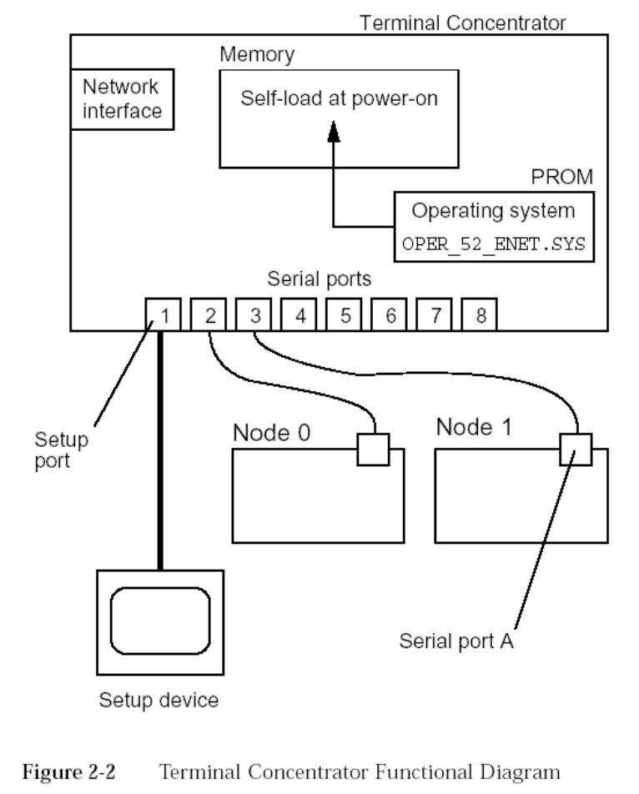

Slide 69
Terminal Concentrator(cont’d)
连线方法（1口是管理口，2－8口可以连接）：
Netra1400：使用TC带的线（一头RJ45，一头DB25头，白色）就可以了。连接在机器的 Console A Port上。
Netra20：连接在机器的LOM口上。需要重新做线： 线序： 12345678/ 87564321
SunFire480：连接在机器侧面的Serial Port上。 需要重新做线： 线序： 12345678/87564321

Slide 70
参考资料
Sun Cluster 3.0 Administration Guide
Sun Cluster 3.0 Hardware Guide
Sun Cluster 3.0 Installation Guide
Ipas-Cluster3.0-standard-installation

Slide 71
Please call our country-wide hotline:
800-810-0035

Slide 72

Thank You
Notes:
Manage the Service, Not the Server!
In the Internet Age, applications are what it's all about. And our SunPlex architecture acknowledges that by providing the premier platform for delivering application services over the Internet.
Sun helps IT keep up with the tremendous scalability and change management demands of Internet application service by giving them the means to manage the service, not the server.

